Slide 1
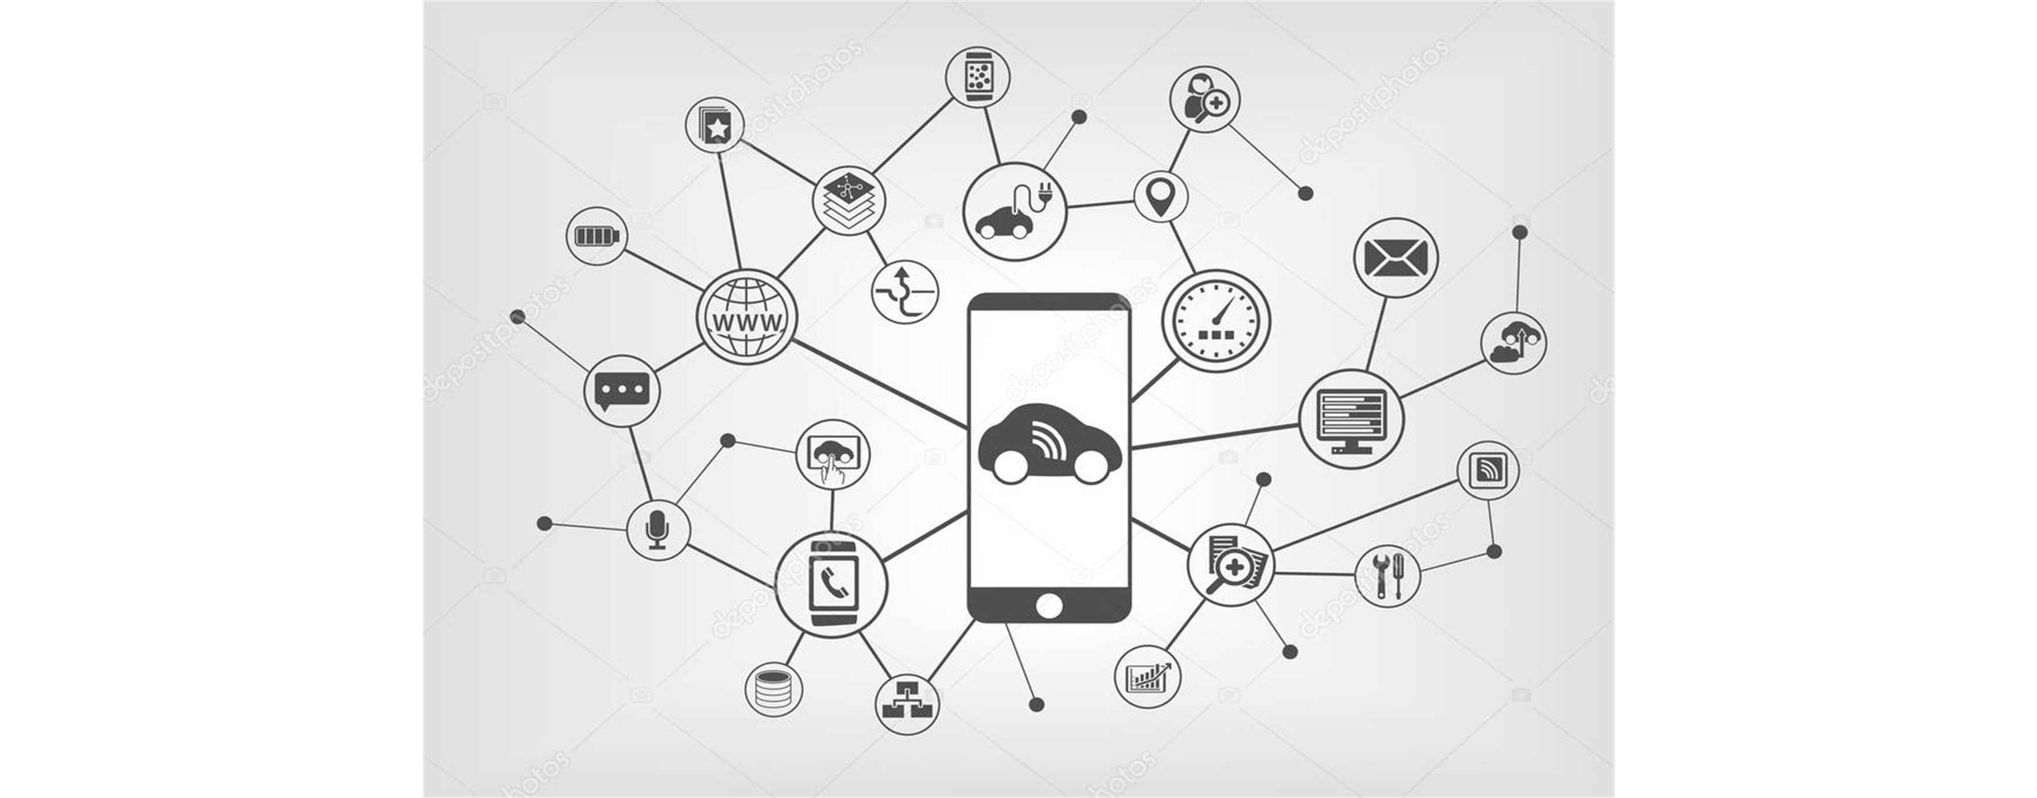
TNCs: Regulation Process in Mexico City A three years overview
LAURA BALLESTEROS M.
Mobility expert
Substitute Senator in Mexican Congress, and Technical Secretary of the Initiative Women in Motion

Slide 2
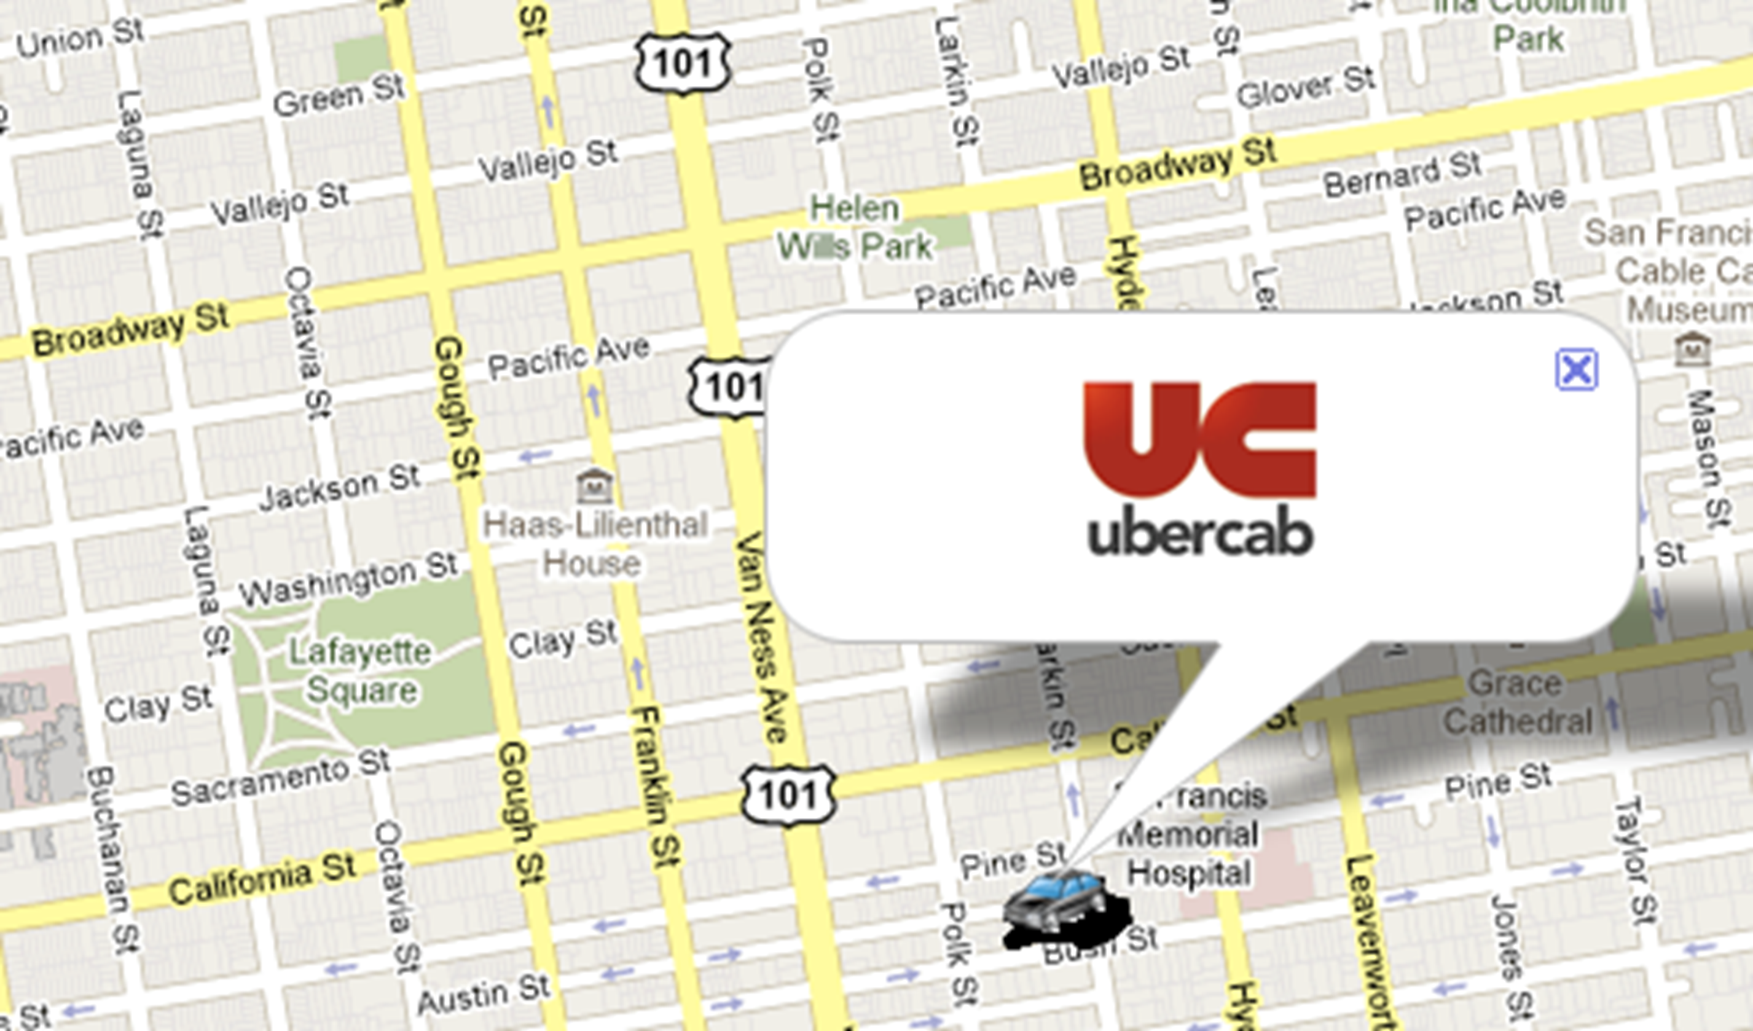
Global context
March 2010
UberCap startup enters US
May 2011
Cabify opens in Spain
June 2014
Uber launches activities in Mexico

Slide 3
Background CDMX

Slide 4
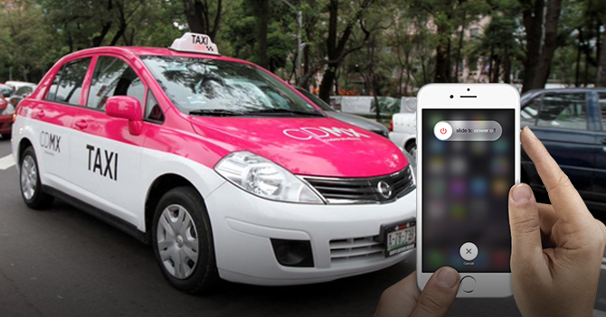
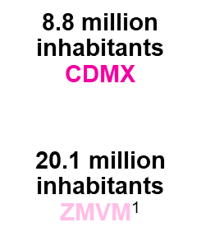

Slide 5
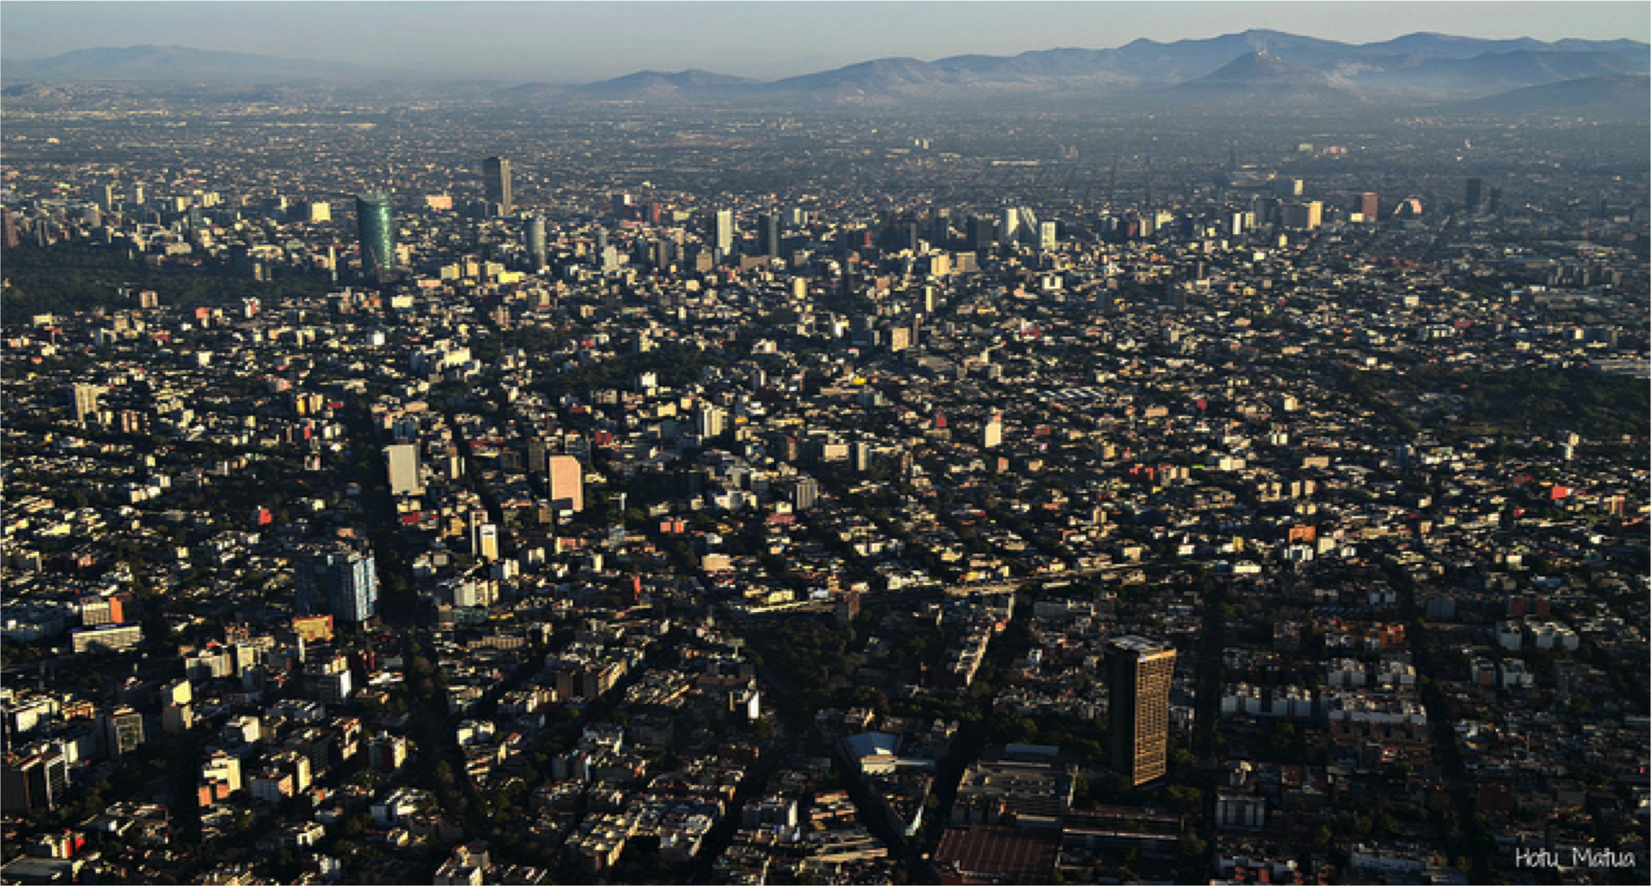
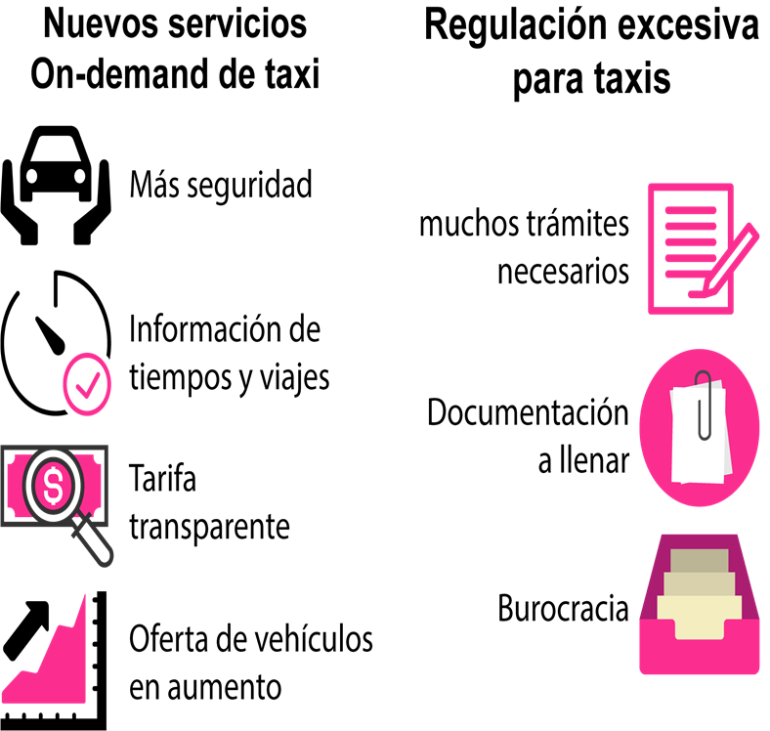
Background CDMX

Slide 6
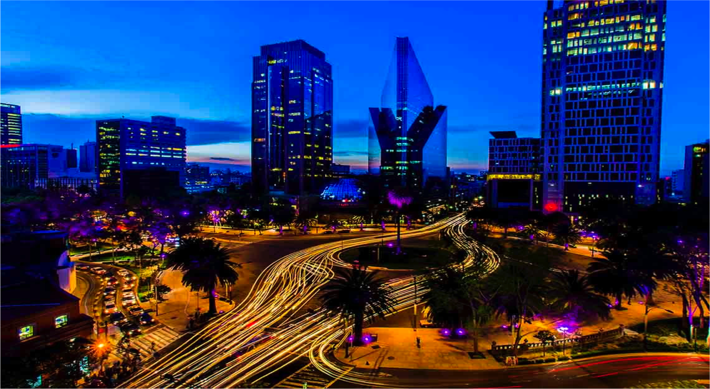
Mobility Law
Technology
Innovation
Regulation
Investment
July 2014

Slide 7
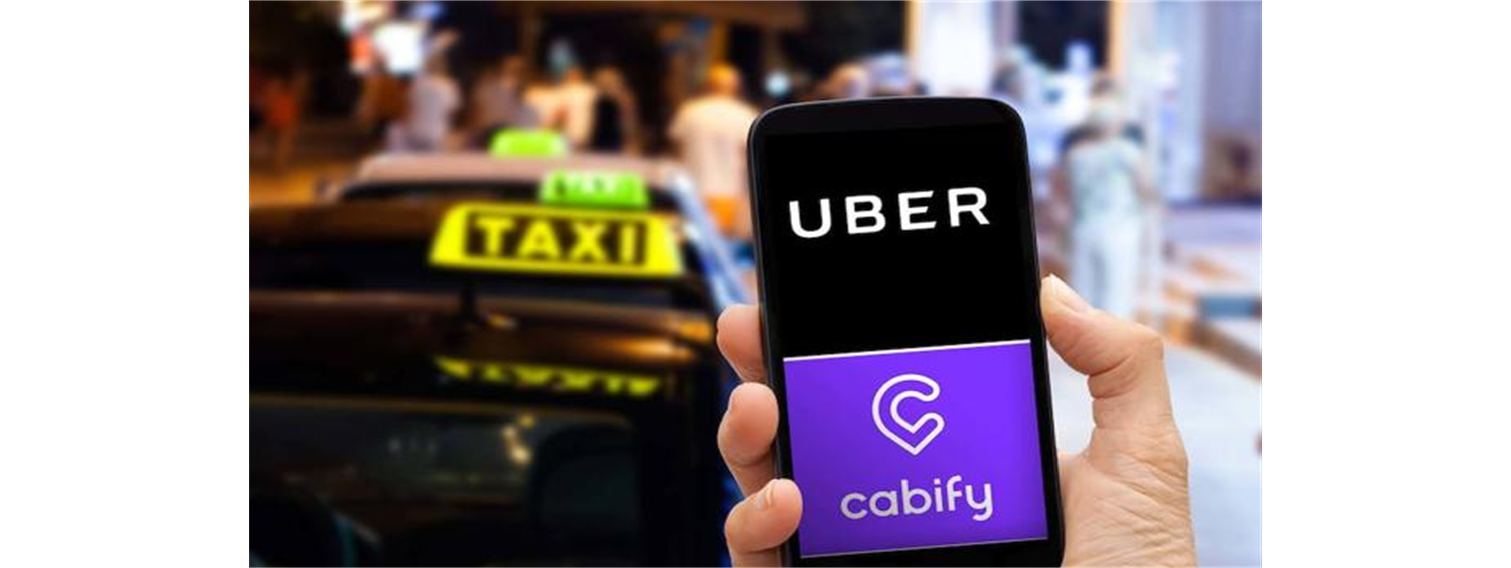
Proposal: New Regulation
June 2015

Slide 8
Negotiation Mechanisms
The creation of a diverse participatory space for the exchanges of ideas and opinions.
Participation of relevant players.
Civic participation.
DEBATE | WORKING GROUPS | RECOMENDATION OF CITIZENSHIPS | CONCLUSIONS | IMPLEMENTATION

Slide 9
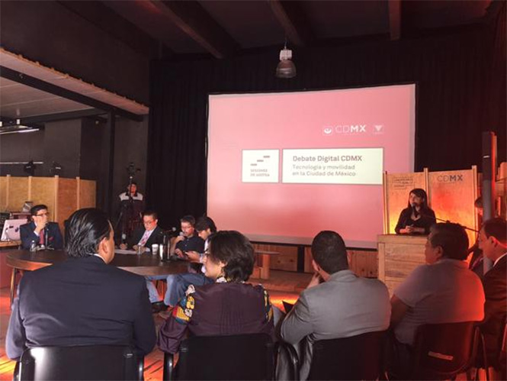
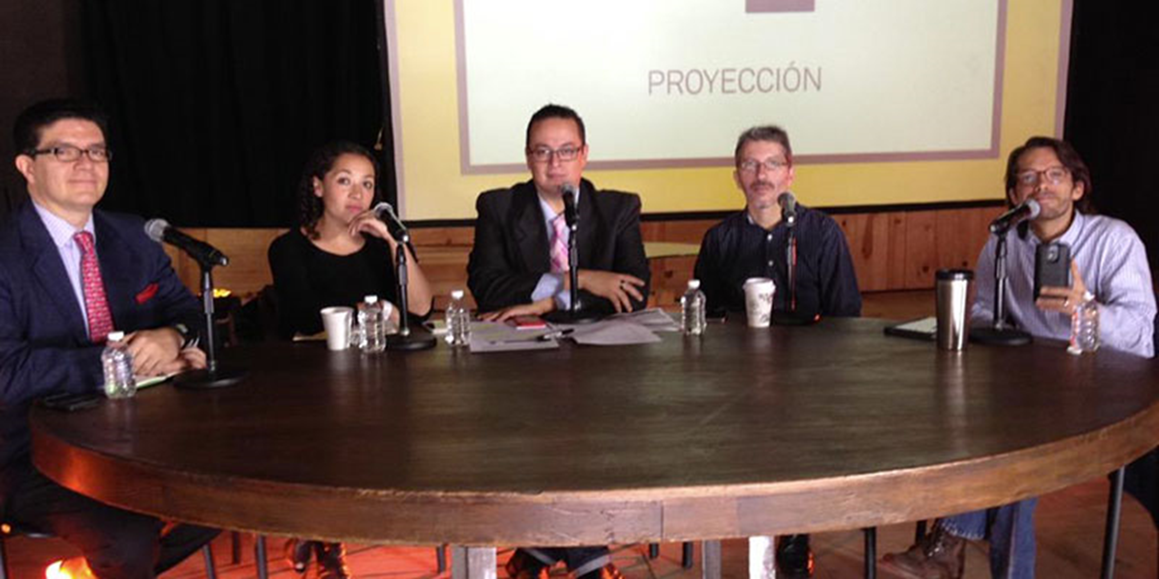
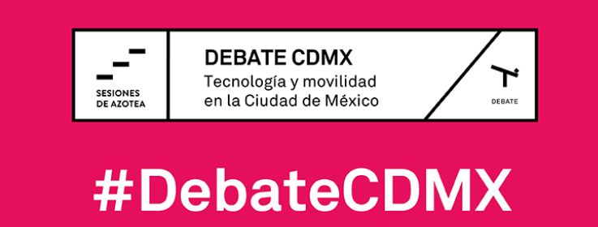
OBJECTIVE
Design and create regulatory strategies

Slide 10
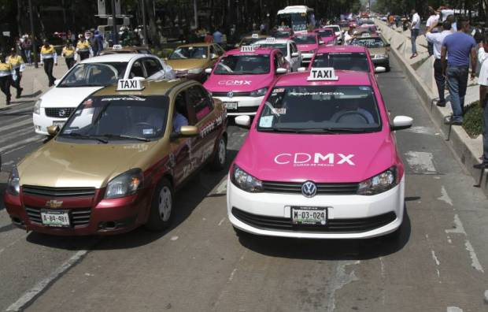
Participants
Debate Digital CDMX

Slide 11
July 2015
New regulation in CDMX.
Hereby is published the Legal Entities Registration Agreement directed toward those legal entities which operates, use and/or manage the mobile apps for Control, Programming and/or Position Tracking on mobile devices, whereby private individual can contract service of public transportation and private taxi driver transportation.

Slide 12
STANDARS
Power to regulate
Apps: Sustainable Technologies
Driver´s Data
Vehicle Documentation
1.5%
Investment to Sustainable Mobility
Notes:
Detalles de la normativa.
SEMOVI tiene facultades para impulsar, ordenar y regular el desarrollo de la movilidad para que los servicios públicos de transporte de pasajeros, sean eficientes y eficaces.
Las APPS para el servicio de taxi se consideran tecnologías sustentables en términos de la Ley de Movilidad
Contar con un registro de personas morales que operen el servicio de taxi, es una cuestión de orden público y seguridad con certeza jurídica en sus traslados.
Tipos de documentación y procedimientos necesarios para dar de alta vehículos y empresas prestadoras de servicios de taxi y de chofer privado.
Por cada viaje realizado , 1.5% es aportado para el “Fondo para el Taxi, la Movilidad y el Peatón”, destinado para la creación de infrastructura accessible y segura.

Slide 13
Uber in CMDX

Slide 14
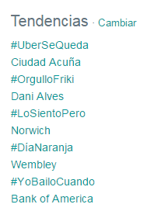
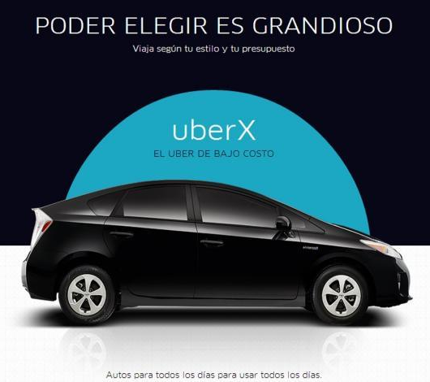
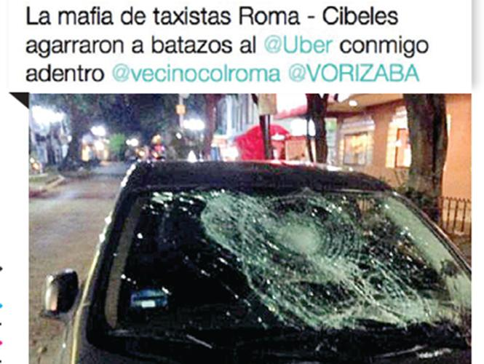
Timeline
June 18, 2014
March 20, 2015
May 25, 2015
January 11, 2016
Uber arrives in Mexico
Taxi vs Uber
TT #UberSeQueda
Start Uber Pool in CDMX
http://www.dineroenimagen.com/2015-03-21/52813
http://www.excelsior.com.mx/hacker/2015/05/25/1025912
https://s3.amazonaws.com/poderpda/2016/04/tarifa-uber.jpg
http://www.sdpnoticias.com/local/ciudad-de-mexico/2016/05/30/buscan-crear-aplicacion-para-uberizar-a-taxis-de-la-cdmx
http://www.xataka.com.mx/gadgets-y-coches/uber-en-mexico-la-competencia-a-taxistas-mexicanos-ha-llegado

Slide 15
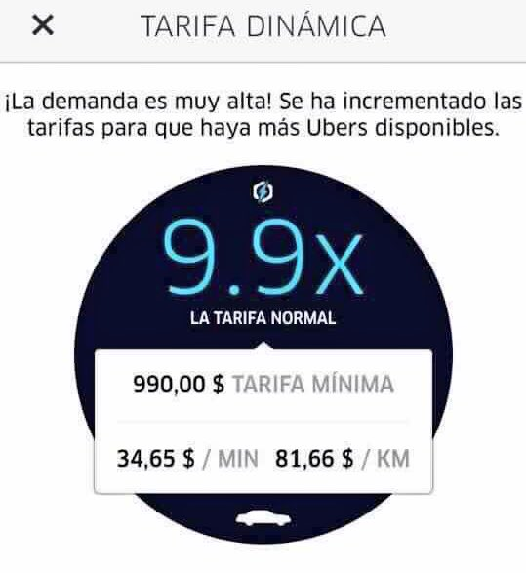
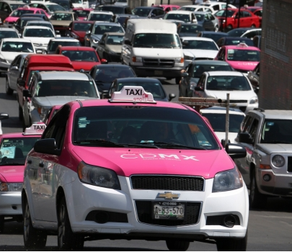
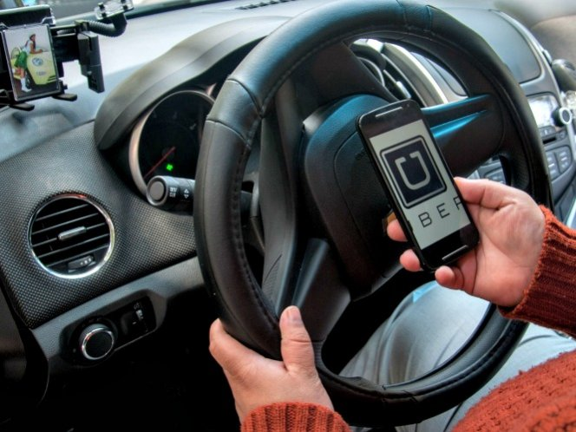
Timeline
April 12, 2016
May 30, 2016
June 17, 2016
July 14, 2016
Surge pricing
LabCDMX and SEMOVI organized debate with apps Uber and Cabify, taxi drivers and experts.
Manifestation of taxi drivers.
Request for suspension of Uber Pool
Implementation of taxis apps.
http://www.informador.com.mx/mexico/2015/599380/6/abren-al-publico-foro-sobre-taxistas-uber-y-cabify-en-el-df.htm
http://www.excelsior.com.mx/comunidad/2016/07/14/1104876
http://www.sdpnoticias.com/local/ciudad-de-mexico/2016/05/30/buscan-crear-aplicacion-para-uberizar-a-taxis-de-la-cdmx

Slide 16
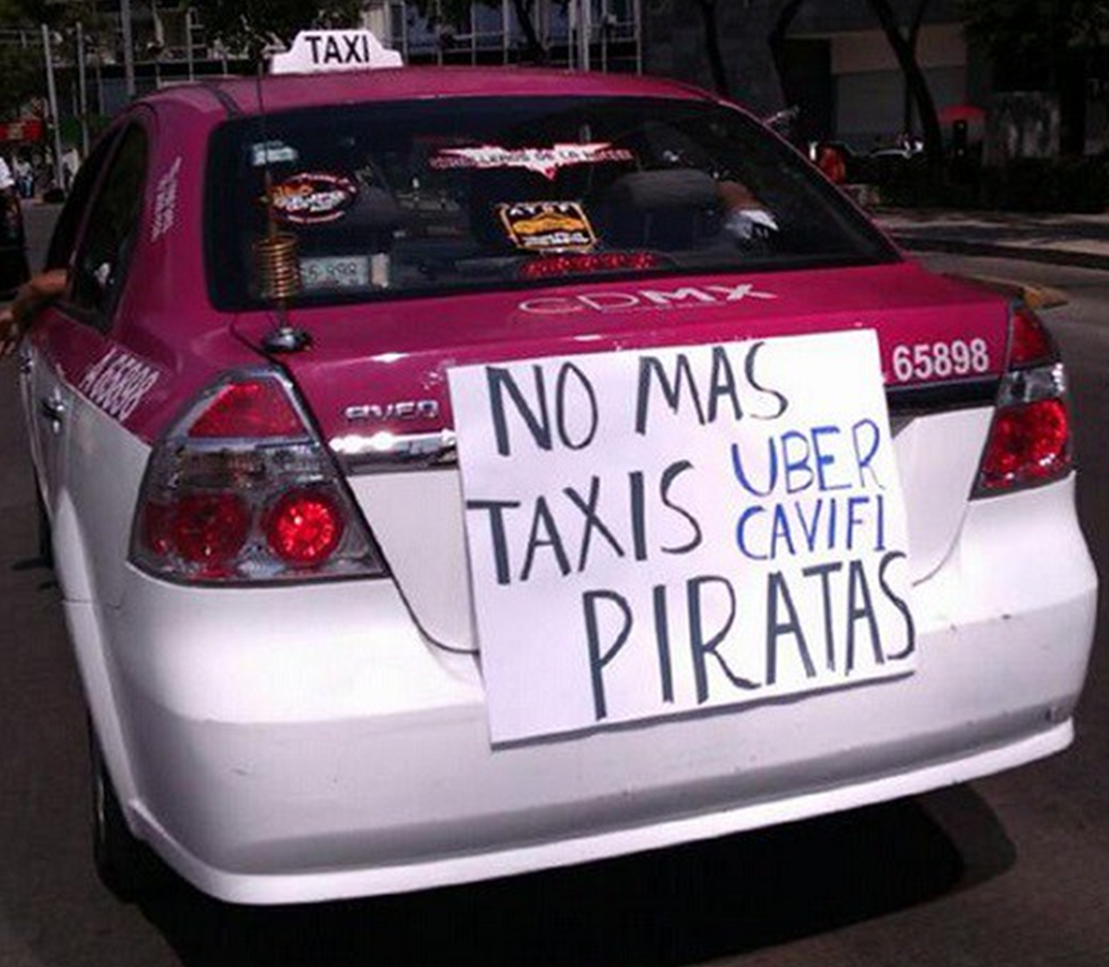
Operating Companies
Dealerships
NGOs
Experts and Civil Society
Government
Automotive Companies
Insurers
Stakeholders

Slide 17
Next steps
Collaboration with
Government / Private Initiative / Civil Society
Strategic alliances
Data collection
Analyze and evaluate
Generate conditions conducive to economic and technical development.

Slide 18
¡Gracias!
@LBallesterosM

